Slide 1

Store Support - AGE
Four Major Projects
Project & Work Management = Activity Hub Platform
Reporting Consistency
Targeting Alignment (Job-Codes to Dept)
AMP First – Protecting Associate Activity Levels

Slide 2
Store Support - AGE
AMP First – Protecting Associate Activity Levels
Creating a Path that sends the following items through AMP First
Store Updates & Notification – Currently being done
Store Visits
Events
Sidekick
Notes
Tour Guides – Digitalizing Store Guides Experience

Slide 3
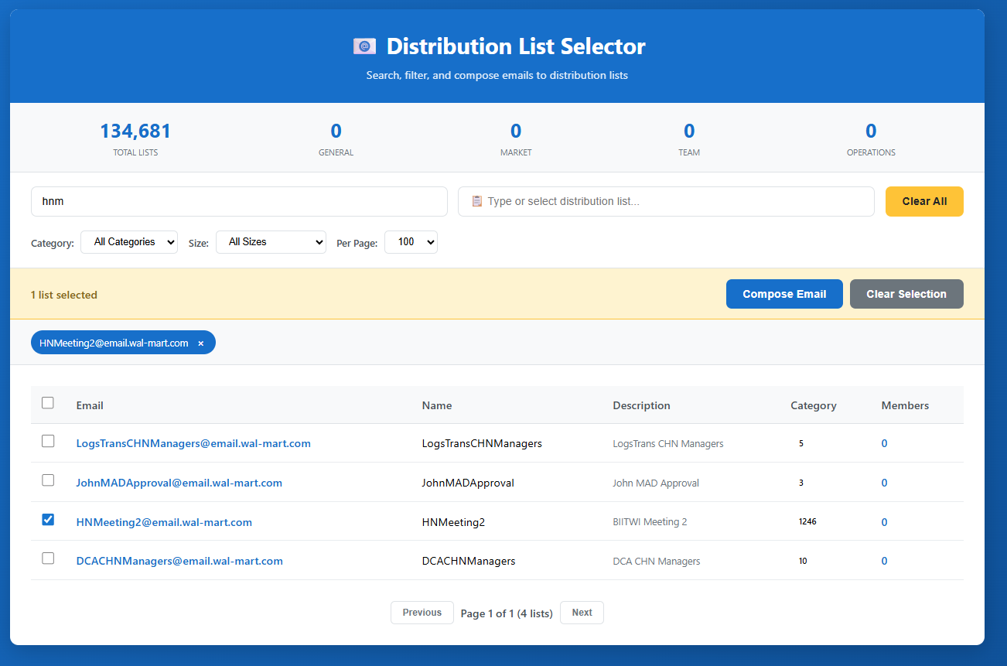
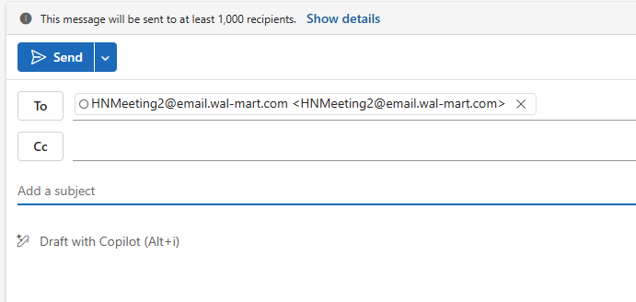
Distribution List Assistant

Slide 4
Store Support - AGE
Tour Guides – Digitalizing Store Guides Experience Project is on track for 1/3/2026.
Next steps:
Testing Next Week
Finalize and Launch 1/3/26
Review and Analyze Data
Business Owner Dashboard Phase 2
Multi-Guide Input/Output
Project Ownership

Slide 5
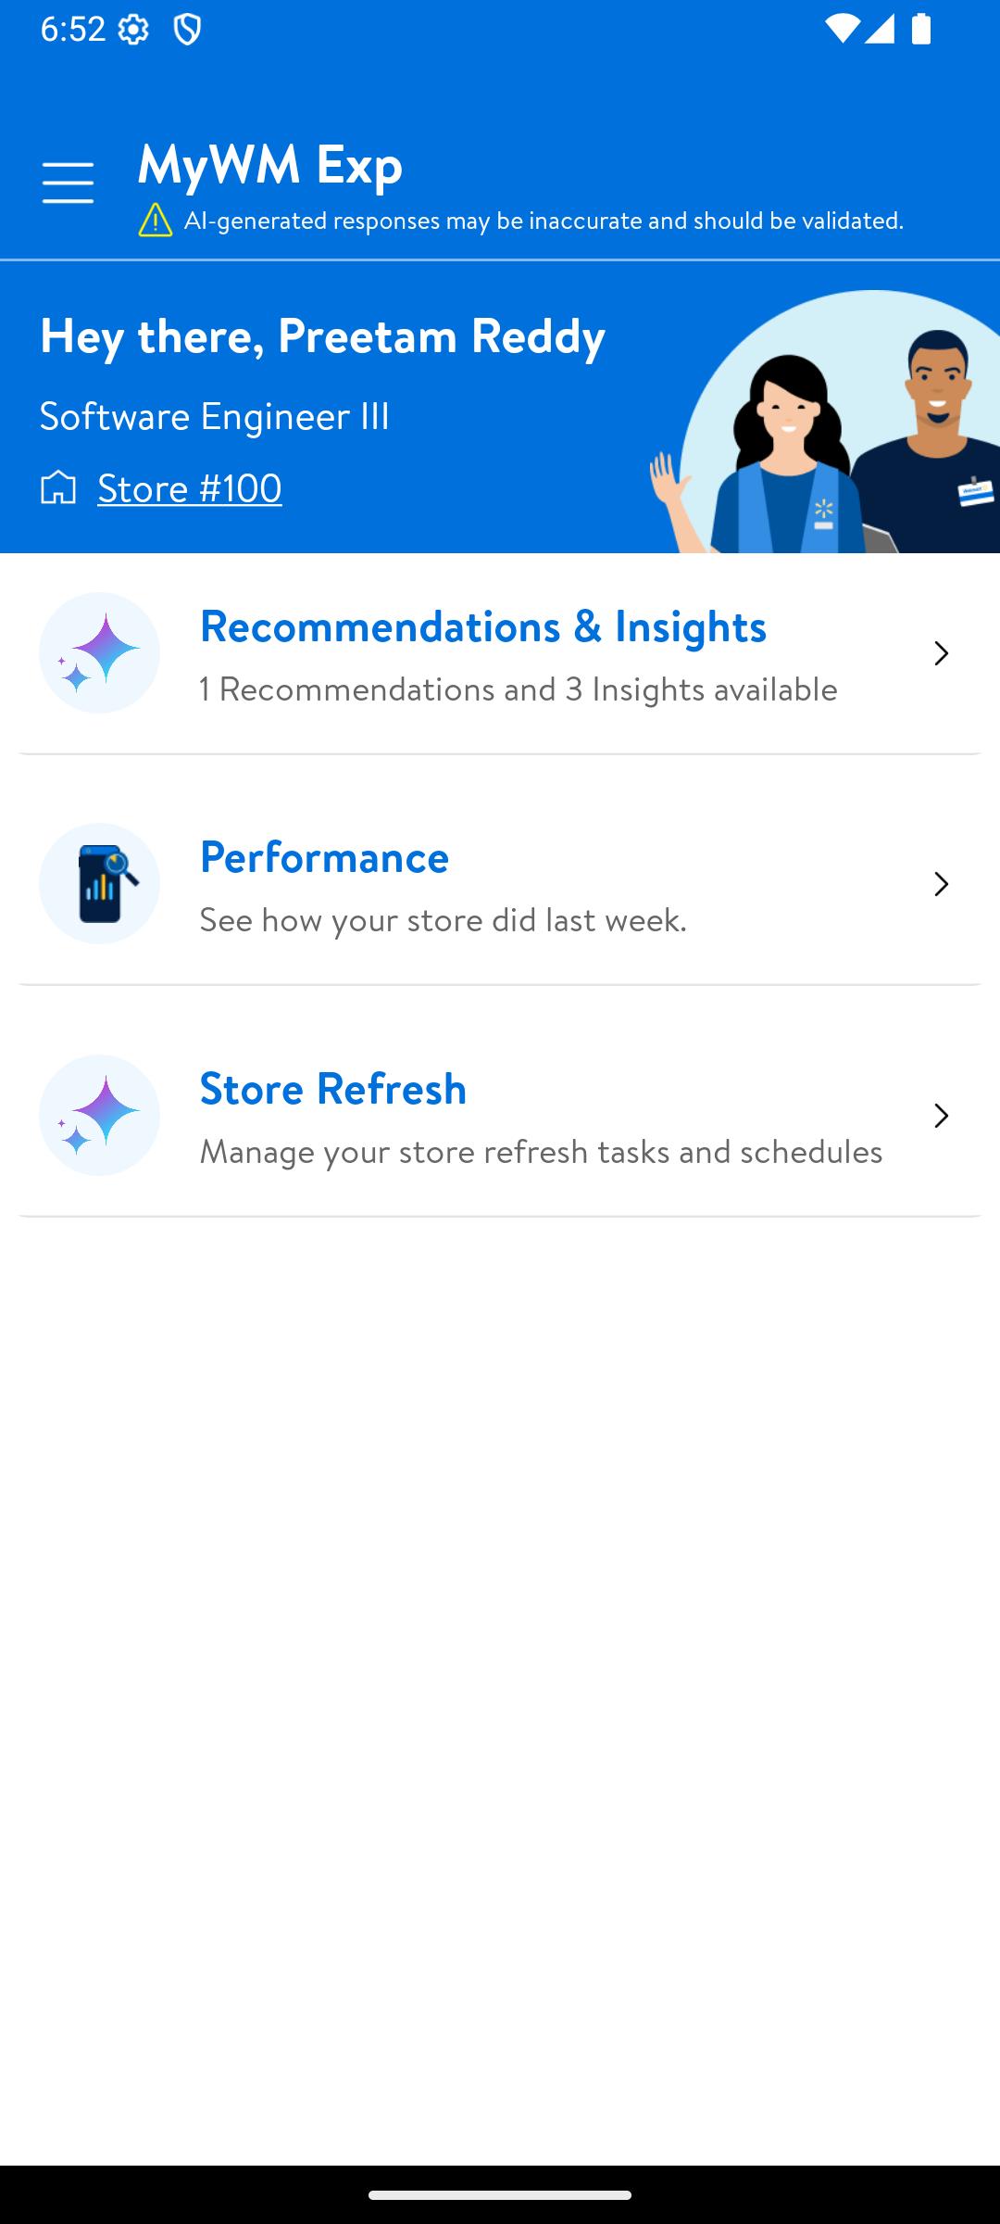
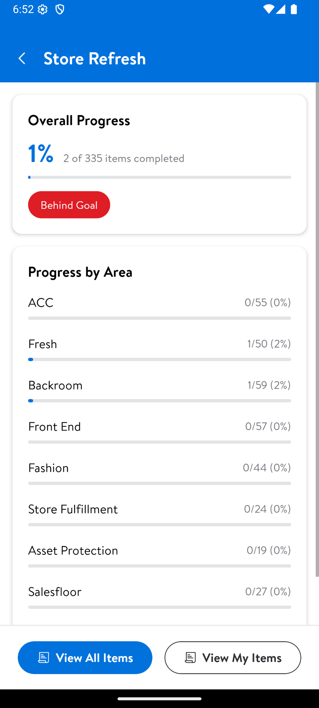
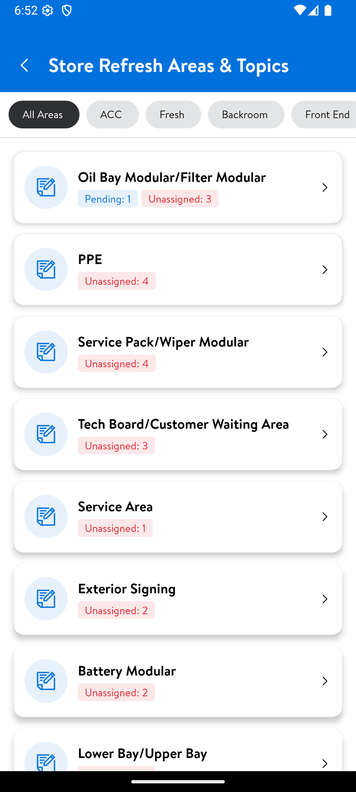
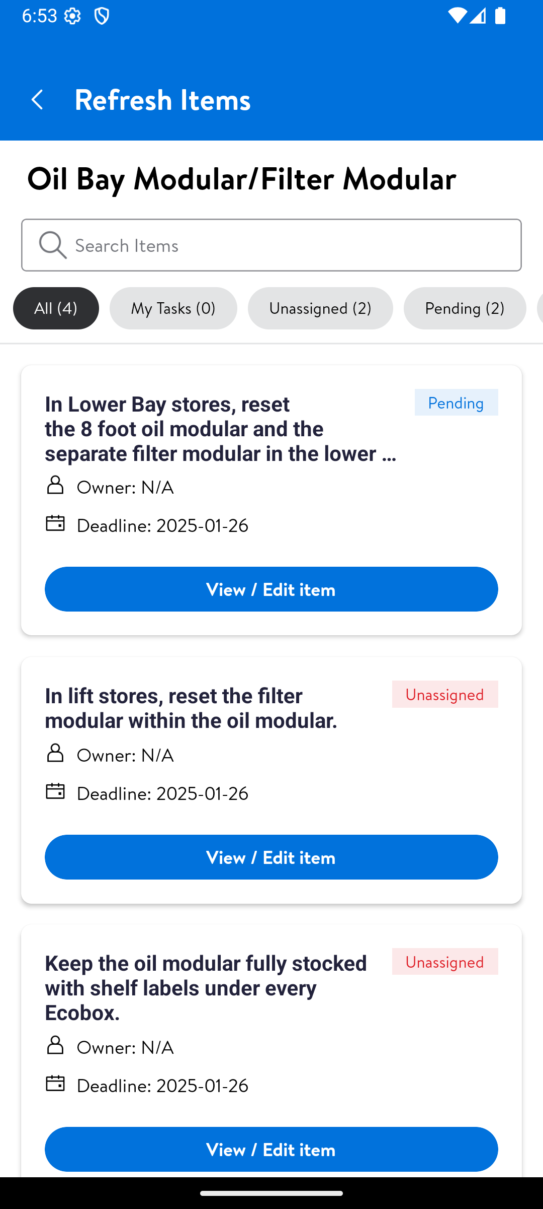
Tour Guides – Store Refresh

Slide 6
Store Support - AGE
Targeting Alignment (Job-Codes to Dept)
Aligning our data and ways of working to ensure that we are reaching the associates in the right places in the store, and across all platforms.

Slide 7
Store Support - AGE
Reporting Consistency
Aligning our reporting to provide consistent Home Office reporting for every area and operational team.

Slide 8
Store Support - AGE
Project & Work Management = Activity Hub Platform
Aligning our projects and the work related to those projects into one place, regardless of the platform they are being worked. This will help provide one source of truth, while not hindering teams' ways of working.

Slide 9
Store Support
Path to Production
Path to Production Infrastructure + Activity Hub Platform
Investment: $636.7K Investment | $25.6M Value | 5,420% ROI
Executive Brief

Slide 10
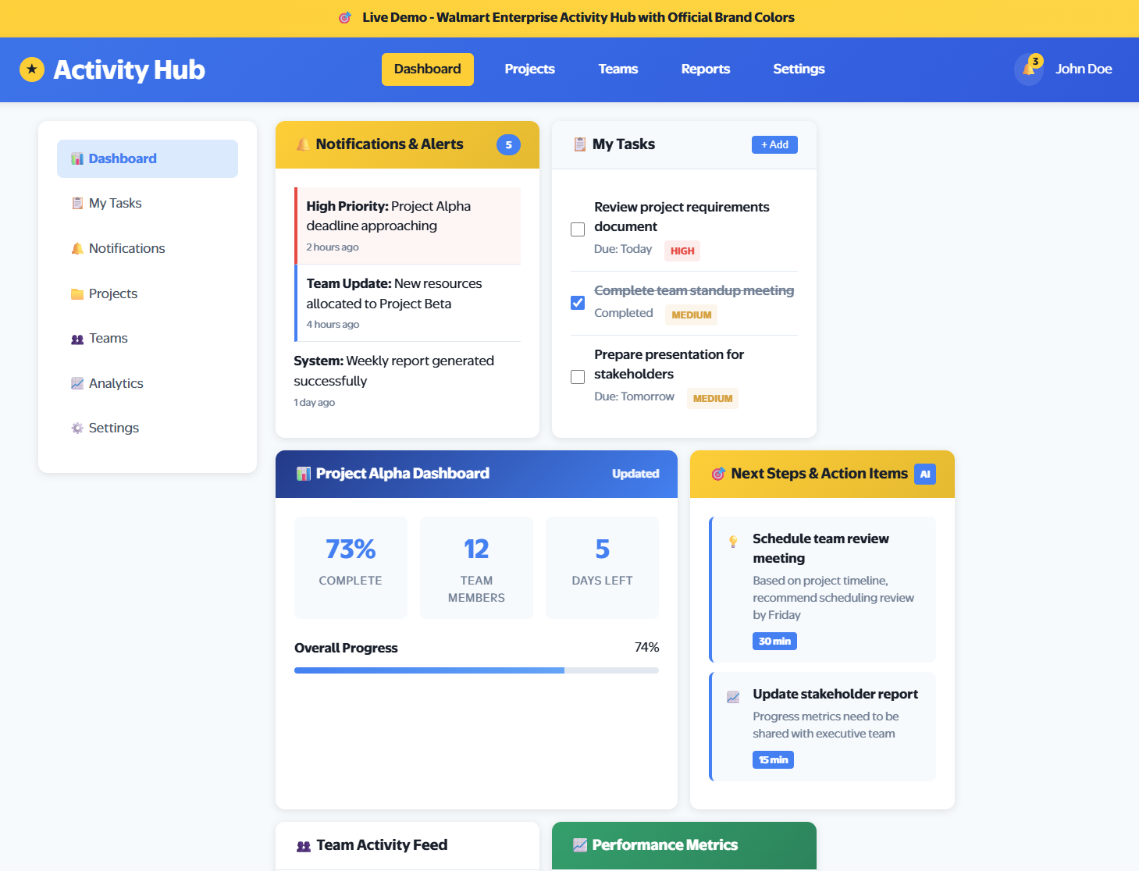
Activity Hub Platform

Slide 11
The Two-Part Ask
PART 1: Path to Production
🏗️ Production infrastructure
🔒 Security & compliance
⚙️ CI/CD pipeline
📊 Support framework
$409K (3 years)
Enables ANY product
PART 2: Activity Hub
🎯 Flagship central integration platform
🔗 Unifies 16 tools
📈 Real-time visibility
⚡ Automated workflows
$228K (one-time)
Immediate ROI proof
The Problem We're Solving:
❌ 15+ disconnected tools creating 275 hrs/week inefficiency
❌ No production deployment capability ($184K per product waste)
❌ Manual processes costing $3.1M annually
❌ Store communication (30-40% message overlap)

Slide 12
How We Ensure Value
📊 Platform Assessment Tool - Quality Control Gateway
✅ Business owners self-evaluate product ideas before requesting development
✅ Instant complexity scoring, cost estimates, and timeline recommendations
✅ Only validated, high-value products enter the expensive Path to Production pipeline
✅ Built-in safeguard ensures $464K infrastructure investment has quality control
The Numbers: Deploy 5 Products Over 3 Years
❌ Without Path to Production:
Product 1: $184K infrastructure
Product 2: $184K infrastructure
Product 3: $184K infrastructure
Product 4: $184K infrastructure
Product 5: $184K infrastructure
Total: $920K
✅ With Path to Production:
Path to Production: $409K
Product 1 (Activity Hub): $278K
Product 2: $55K
Product 3: $55K
Product 4: $55K
Product 5: $55K
Total: $8557K | Save $63K (7%)

Slide 13
Timeline & Benefits
⏱️ Implementation Timeline
Months 1-2: Foundation
APM registration, Azure setup
Months 3-4: Security
SSP approval, compliance
Month 5: Testing & Deploy
CI/CD pipeline, Activity Hub
Month 6+: Value Realization
Additional products follow
💰 Annual Benefits Breakdown
Process Efficiency:
$15.6M (275 hrs/week saved)
Infrastructure Savings:
$2.1M (reusable platform)
Better Decision Making:
$1.4M (real-time data)
Productivity Improvement:
$6.2M (15% delivery improvement)
Administrative Reduction:
$3.1M (30% task time savings)
Collaboration:
$2.1M (40% cross-functional efficiency)
Total Annual: $27M
3-Year Total: $81M
Break-Even: Month 2 | Every month of delay costs $262K

Slide 14
Ready to Transform Store Support?
We Need Two Approvals:
☑️ Path to Production Infrastructure
$409K over 3 years
☑️ Activity Hub Platform
$228K one-time
$637K Investment | $81M Value
4,021% ROI | Break-Even: Month 3
Target Launch: August 2026
Let's Build the Future of Store Support
Executive Brief

